Slide 1
SCALA PROJECT
Hedge Fund Application: Real Time Stock Recommender
Team 2:
Shreya Nair
Amit Pingale
Mayank Gangrade

Slide 2
Goal
Building reactive application for portfolio management and business analysis
Leveraging:
Kafka + Spark streaming
Spark Analysis engine
MongoDB for maintaining historic records + batch processing (Future Scope)

Slide 3
Why Real-time Big Data Pipeline Important
It is estimated that by 2020 approximately 1.7 megabytes of data will be created every second. This results in an increasing demand for real-time and streaming data analysis. For historical data analysis descriptive, prescriptive, and predictive analysis techniques are used. On the other hand, for real-time data analysis, streaming data analysis is the choice. The main benefit of real-time analysis is one can analyze and visualize the report on a real-time basis.

Slide 4
Technology and Tools:
Alpha Vantage API for Real Time Data
Kafka for capturing Real Time Data
Spark Streaming For Consuming Data
Spark + Scala for performing Analysis on the data
MongoDb*
* Try to dump historic data on NoSQL database like MongoDB

Slide 5
Analysis on Data
Data features: Options / Stocks
Linear Regression
Decision Tree Regression
Random forest Regression
Contract Name
Last Trade Date
Strike
Type
Last Price
Bid
Ask
Change
% Change
Volume
Open Interest
Implied Volatility

Slide 6
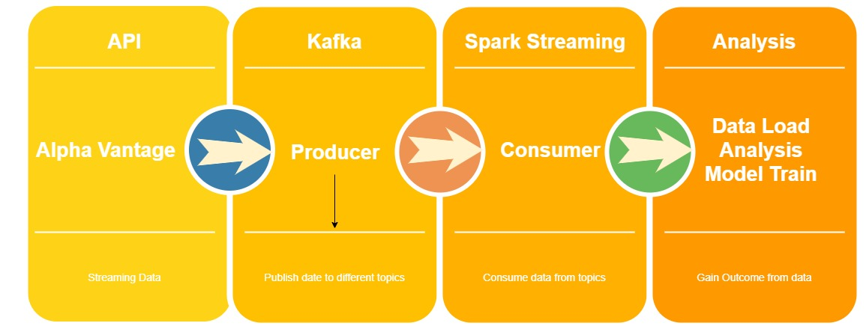
High Level Architecture

Slide 7
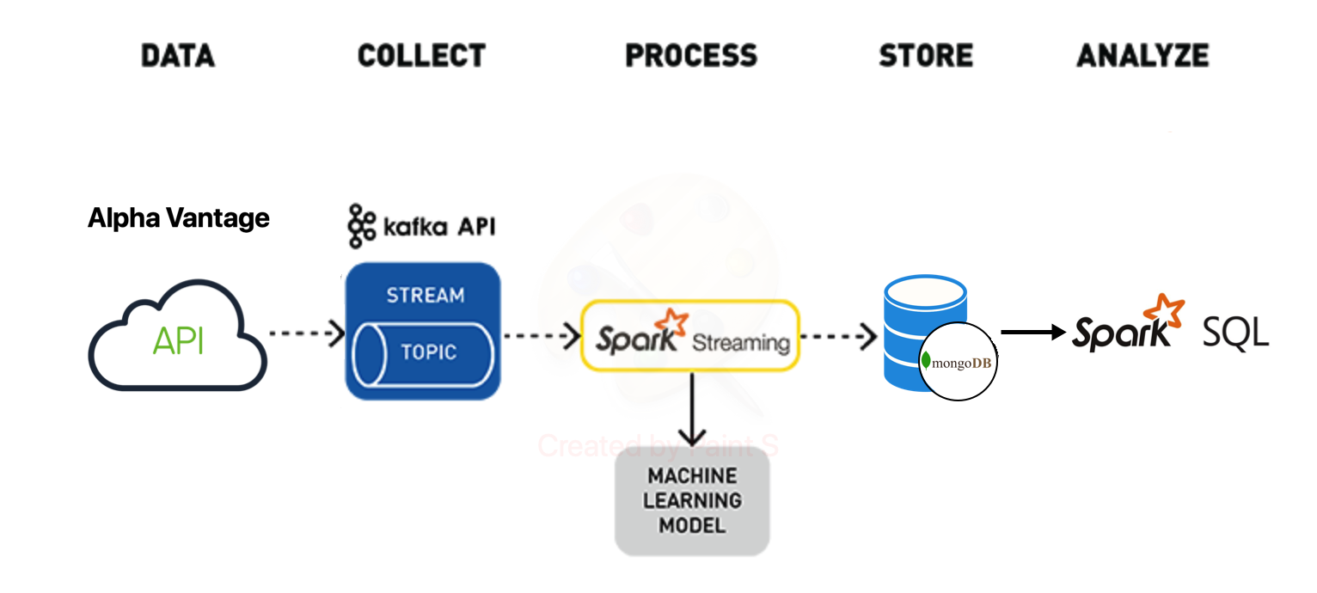
Architecture

Slide 8
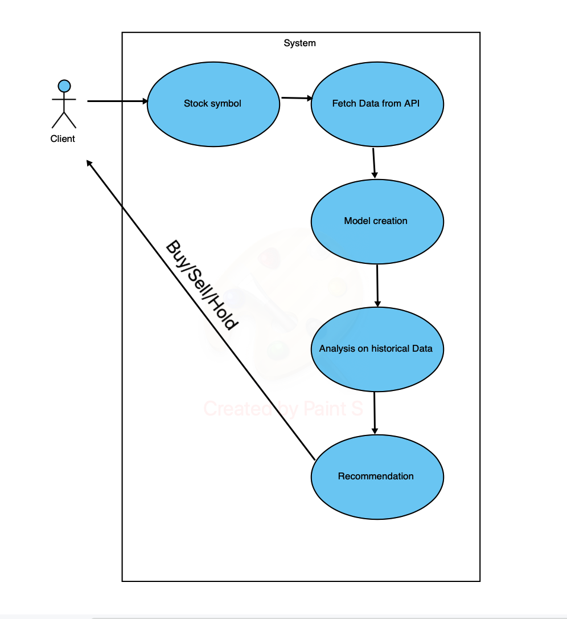
Use Case Diagram

Slide 9
Milestones
Nov 15 -> Project Proposal Acceptance
Nov 22 ->Infrastructure ready (API + Kafka + Spark Streaming + Spark Analytics Engine + MongoDb)
Nov 29 ->Build model + Tune Hyper-parameters
Dec 6 -> Test cases and final evaluation

Slide 10
Acceptance criteria
Fetching stock/option data every 5 mins and Deploying Kafka cluster on single node(pseudo)
Analysing and Predicting (~ 75 % accuracy) the periodic incoming data with help of historic data and dump that data in DataBase(MongoDB)

